Slide 1
Fundamentals of Accelerated Data Science
NVIDIA Deep Learning Institute

Slide 2
An Introduction to Data Science with a Focus on Speed and Efficiency
NVIDIA Deep Learning Institute

Slide 3
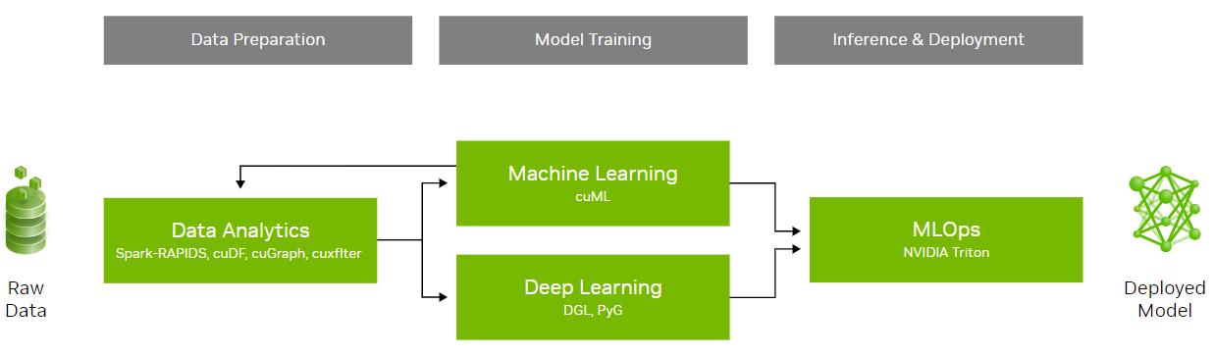
What This Course Will Cover
An introduction to data science with a focus on speed and efficiency
Learning objectives:
Overview of data science
Demonstrations of accelerated data science pipelines
How acceleration is achieved and its implications
This workshop will not cover:
Neural networks (accelerated by cuDNN)
Statistical analysis
 | Course Outline
Task 1 | Data science overview Data manipulation
Task 2 | Machine learning
Task 3 | Graph analytics
Coding Assessment | Biodefense

Slide 4
Section Agenda
• | Data Science Fundamentals
• | RAPIDS
• | Accelerating and Scaling Data Manipulation
• | Hands-On Lab

Slide 5
Data Science Overview
The study of data to extract meaningful insights
Data science is a multidisciplinary approach that combines principles and practices from the fields of mathematics, statistics, artificial intelligence, and computer engineering to analyze large amounts of data.
More than just quantitative analysis - it combines knowledge in using tools, methods, and technology to generate meaning from data
Helps to ask and answer questions like:
Descriptive Analysis (what happened)
Diagnostic Analysis (why it happened)
Predictive Analysis (what will happen)
Prescriptive Analysis (what can be done with the results)
Business
Math & Statistics
Computer Science
Data Science

Slide 6








Data Science Is the Key to Modern Business
Enables data-driven decision making
Retail
Telecom
Healthcare
Manufacturing
Supply Chain & Inventory Management
Price Management / Markdown Optimization
Promotion Prioritization And Ad Targeting
Detect Network/Security Anomalies
Forecasting Network Performance
Network Resource Optimization (SON)
Improve Clinical Care
Drive Operational Efficiency
Speed Up Drug Discovery
Remaining Useful Life Estimation
Failure Prediction
Demand Forecasting
Financial Services
Consumer Internet
Oil & Gas
Automotive
Claim Fraud
Customer Service Chatbots/Routing
Risk Evaluation
Ad Personalization
Click Through Rate Optimization
Churn Reduction
Sensor Data Tag Mapping
Anomaly Detection
Robust Fault Prediction
Personalization & Intelligent Customer Interactions
Connected Vehicle Predictive Maintenance
Forecasting, Demand, & Capacity Planning

Slide 7
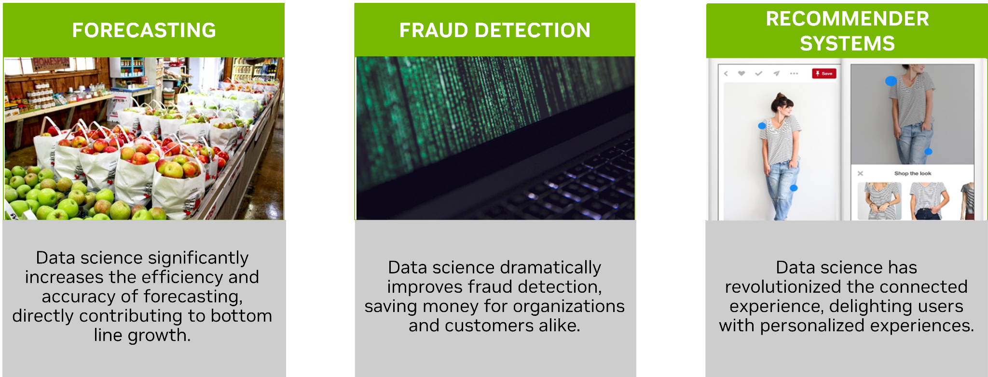
Key Industry Use Cases
Forecasting, fraud detection, recommender systems, and more…

Slide 8
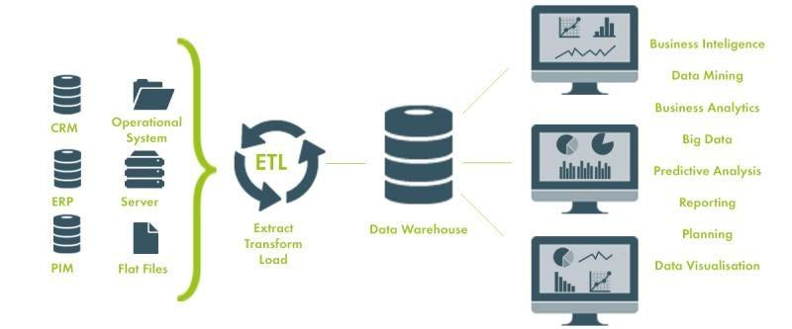
Data Science Is More Than Machine Learning
Non-analytical tasks related to data science are equally important
Analytical tasks include:
Machine learning model development
Measuring key metrics
Statistical analysis
Data visualizations
Non-analytical tasks (upstream) include:
Extract, transform, and load (ETL)
Data collection
Data cleaning and preprocessing
Data modeling
Data engineering

Slide 9
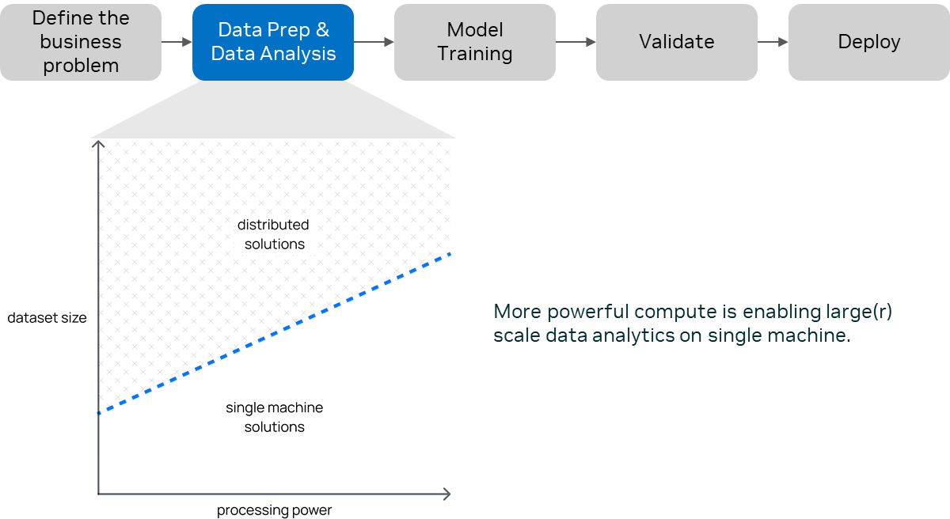
Data Analytics is a Bottleneck for AI Pipelines
40% of data scientist’s time

Slide 10
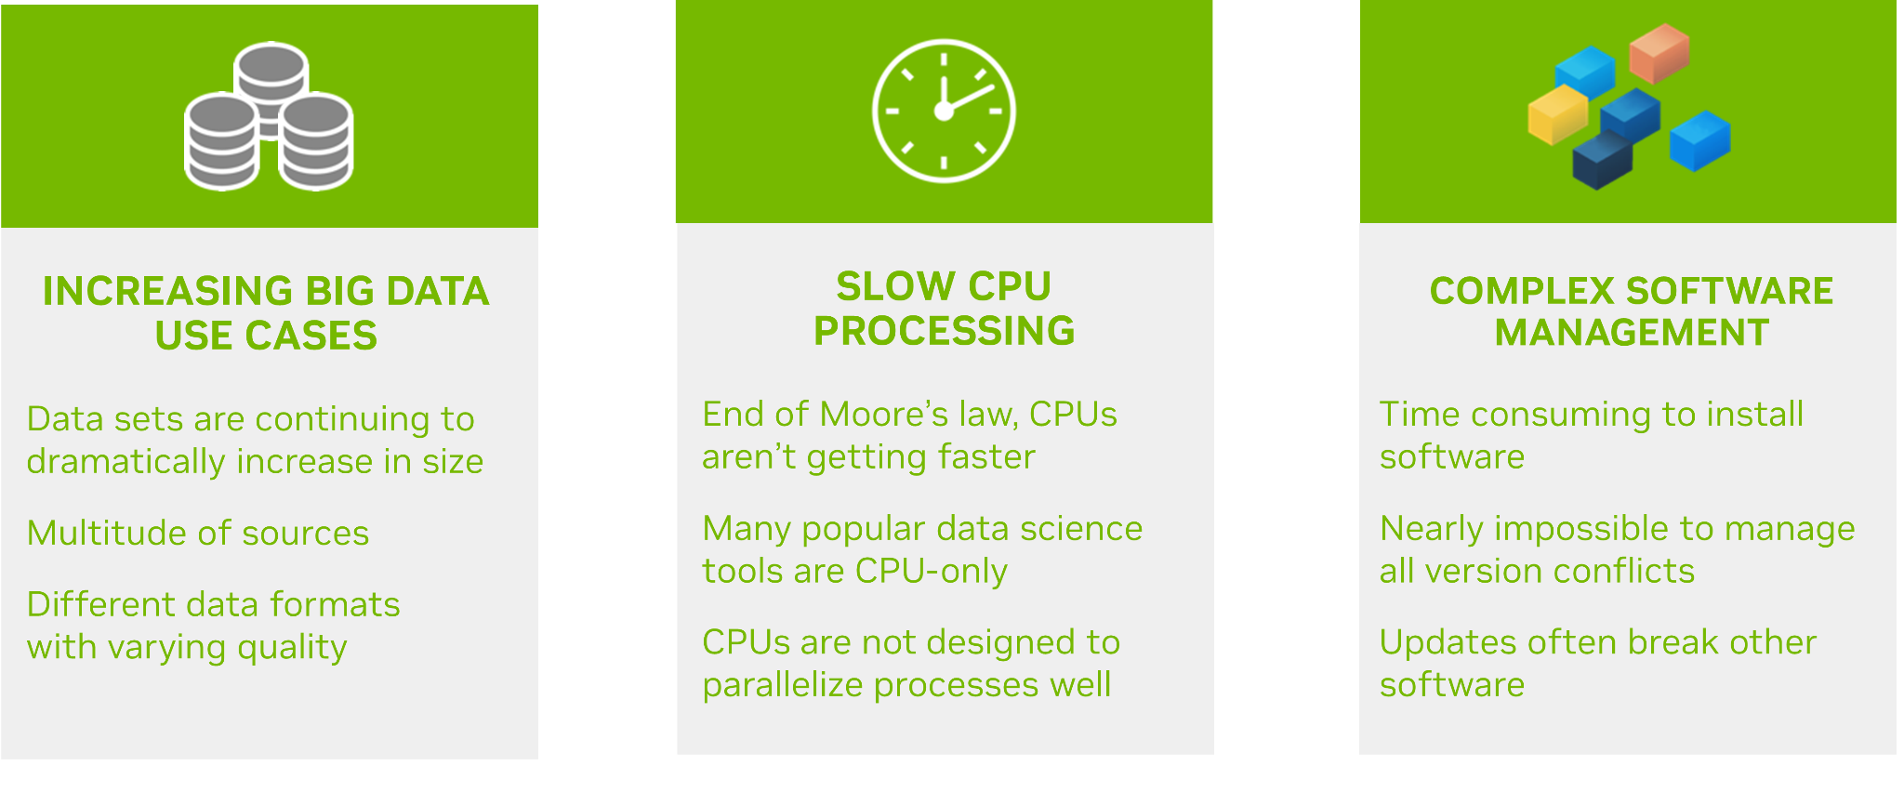
Challenges in Data Science Today
What needs to be solved to empower data scientists
well

Slide 11
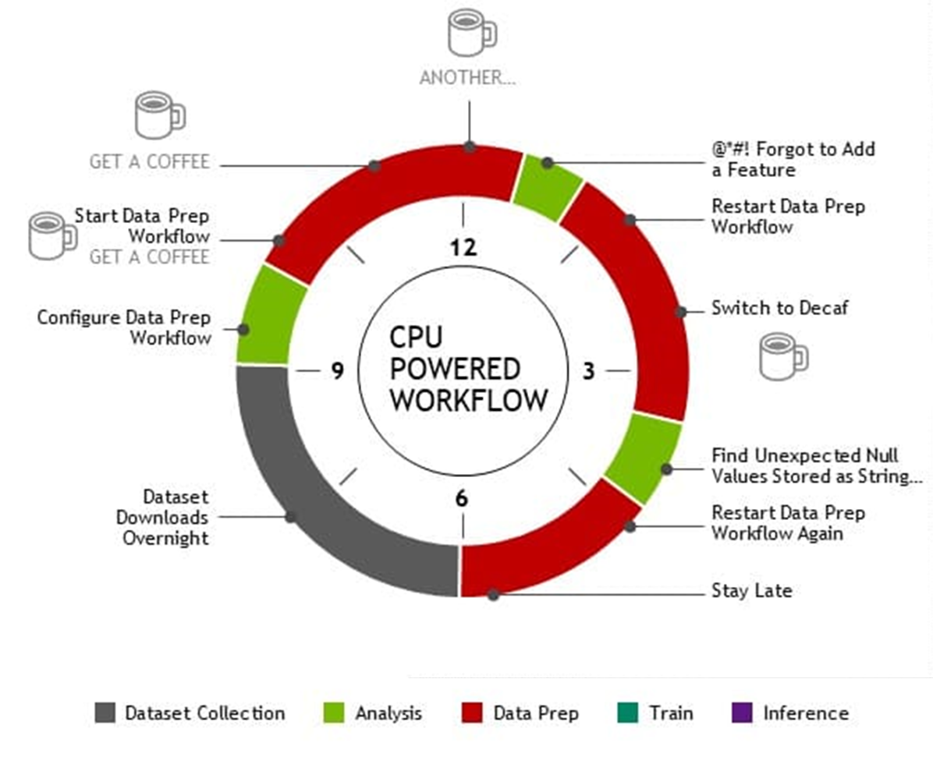
Challenges in Data Science Today
The right solution enables data scientists to focus on delivering value
Data preparation is a time-consuming process
Data science requires exploration and experimentation to:
Deal with uncertainties
Discover and adapt to unexpected insights
Validate, refine, and optimize results
Size, speed, and complexity of data continues to grow
Amount of data that can be analyzed is limited due to resource constraints
Existing solutions are complex when talent is in short supply

Slide 12
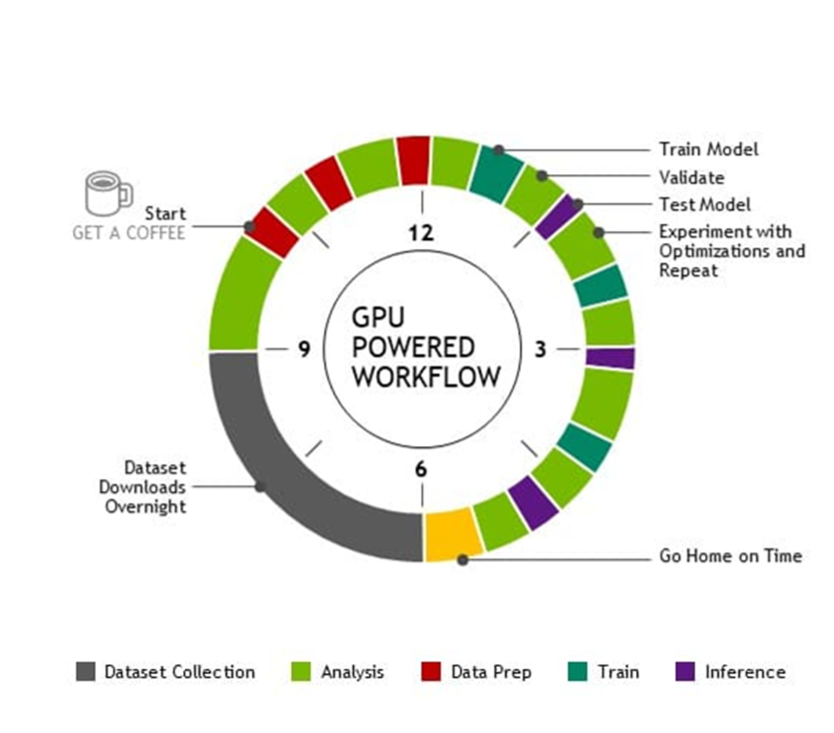
Challenges in Data Science Today
The right solution enables data scientists to focus on delivering value
Faster data processing is key
Benefits of accelerated data science workflows:
Higher productivity
More explorations and iterations can improve model accuracy and optimize inference performance
Lower time to insight and total cost of ownership

Slide 13
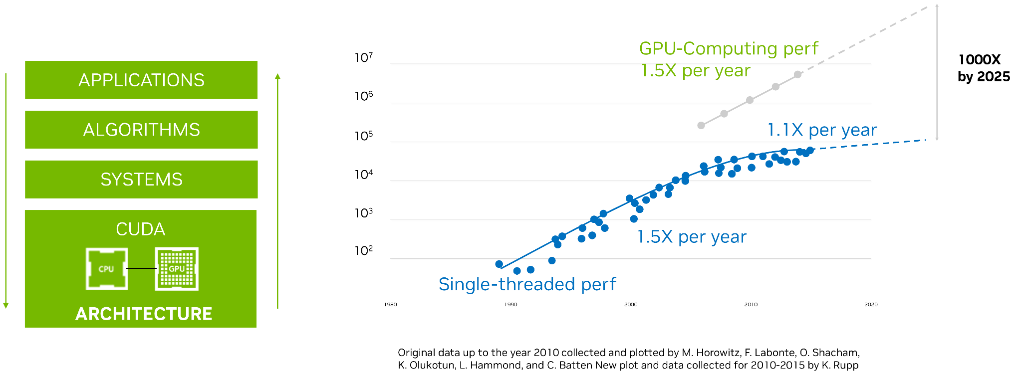
Rise of GPU Computing
Leverages parallel processing to handle large datasets

Slide 14
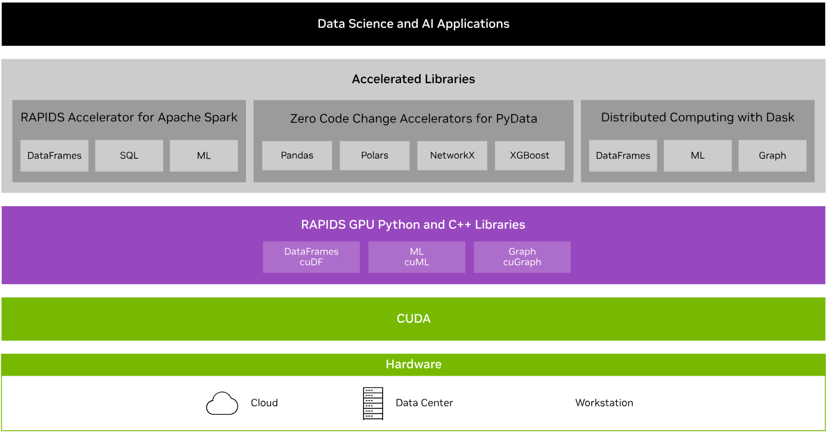
RAPIDS Transforms Data Science
An optimized hardware-to-software stack for the entire data science pipeline

Slide 15
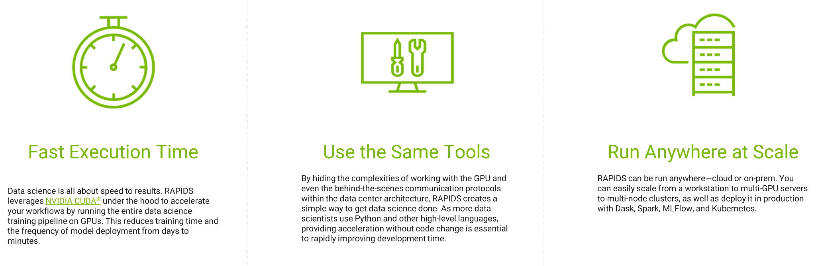
Pillars of Data Science Performance
Empower data scientists to do their best work
Enable acceleration while minimizing friction related to infrastructure

Slide 16
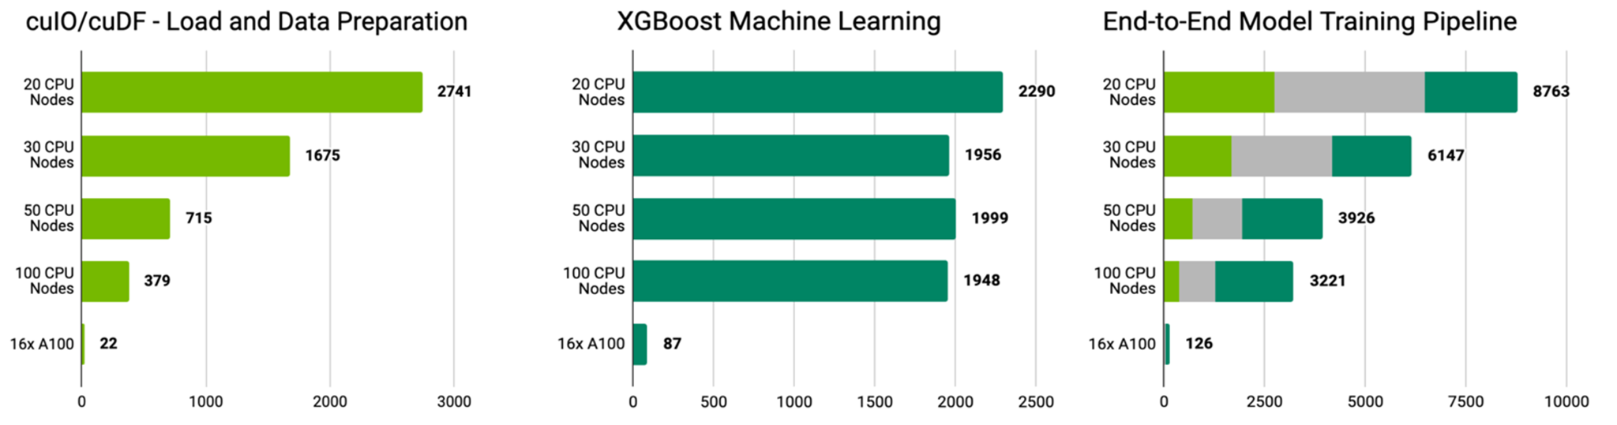
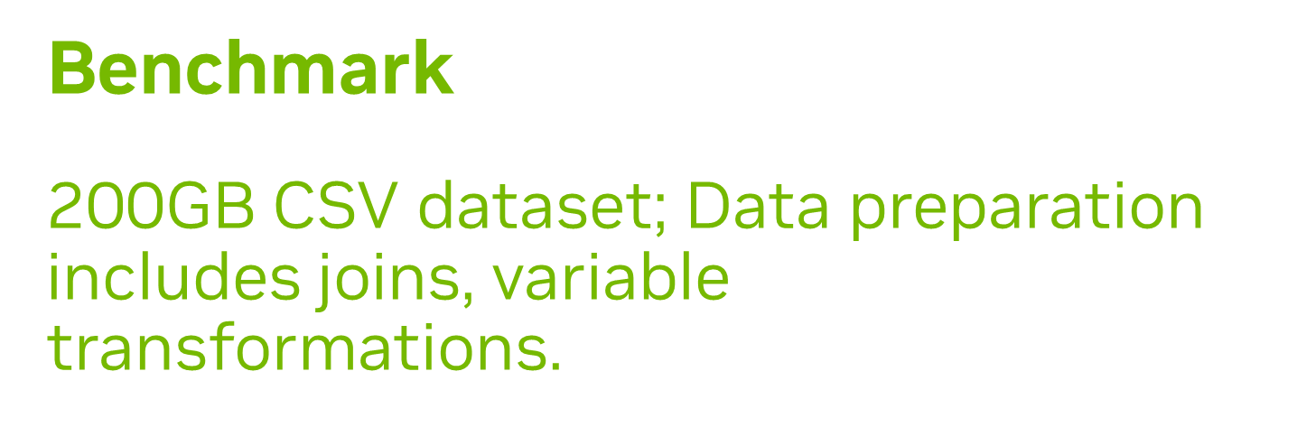
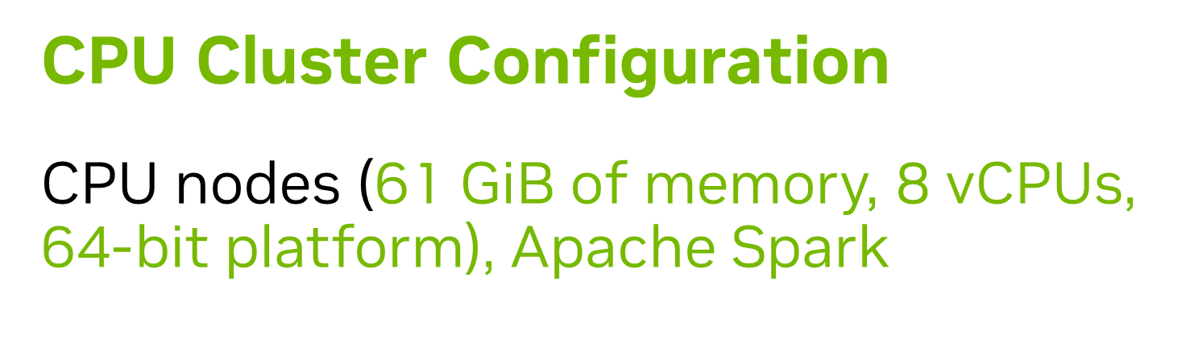

Proven Faster for Data Science
Realize efficiency and scalability with multi-GPU for massive datasets

Slide 17
DataFrame
Data structure is distinguished by type, industry, modality, and the tools used to manipulate
Structured (predefined format/schema):
Tables
Spreadsheets
CSVs
JSONs (semi-structured)
Relational databases
Unstructured (doesn’t follow a specific data model or schema):
Texts
Images
Audios
Genes
Graphs

Slide 18
DataFrame
Data structure is distinguished by type, industry, modality, and the tools used to manipulate
Structured (predefined format/schema):
Tables
Spreadsheets
CSVs
JSONs (semi-structured)
Relational databases
Unstructured (doesn’t follow a specific data model or schema):
Texts
Images
Audios
Genes
Graphs
 | Column 1 | Column 2 | Column 3
Row 1 | 1 | 2 | 3
Row 2 | 2 | 3 | 4
Row 3 | 3 | 4 | 5

Slide 19
DataFrame
Data structure is distinguished by type, industry, modality, and the tools used to manipulate
Structured (predefined format/schema):
Tables
Spreadsheets
CSVs
JSONs (semi-structured)
Relational databases
Unstructured (doesn’t follow a specific data model or schema):
Texts
Images
Audios
Genes
Graphs
 | Column 1 | Column 2 | Column 3
Row 1 | 1 | 2 | 3
Row 2 | 2 | 3 | 4
Row 3 | 3 | 4 | 5

Slide 20
DataFrame
Data structure is distinguished by type, industry, modality, and the tools used to manipulate
Structured (predefined format/schema):
Tables
Spreadsheets
CSVs
JSONs (semi-structured)
Relational databases
Unstructured (doesn’t follow a specific data model or schema):
Texts - sequence of characters, words, and sentences
Images - 2D array of pixels
Audios - sequence of amplitude and frequency (waveform)
Genes - sequence of proteins or graphs
Graphs
1
2
3
2
3
4
3
4
5
Structure will play a role in acceleration, when we can represent data as vectors

Slide 21
Basic Idea
Vectorized operations are typically much faster than equivalent loops or iterations
Problem: (Column 1 - Column 2) * Column 3:
Iterative:
(1 - 2) x 3 = -3
(2 - 3) x 4 = -4
(3 - 4) x 5 = -5
Vector operation (able to leverage parallel processing):
 | Column 1 | Column 2 | Column 3
Row 1 | 1 | 2 | 3
Row 2 | 2 | 3 | 4
Row 3 | 3 | 4 | 5
1
2
3
2
3
4
-3
-4
-5
( )
3 4 5

Slide 22
Basic Idea
Total performance scales with both vector width and number of cores
Problem: (Column 1 - Column 2) * Column 3:
Iterative:
(1 - 2) x 3 = -3
(2 - 3) x 4 = -4
(3 - 4) x 5 = -5
Vector operation (able to leverage parallel processing):
 | Column 1 | Column 2 | Column 3
Row 1 | 1 | 2 | 3
Row 2 | 2 | 3 | 4
Row 3 | 3 | 4 | 5
1
2
3
2
3
4
-3
-4
-5
( )
3 4 5

Slide 23
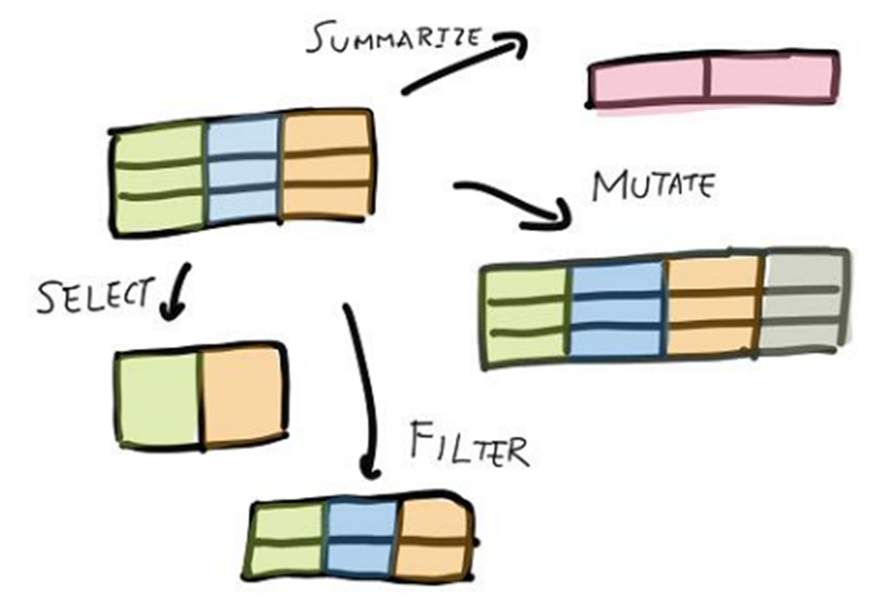
How Data Science Uses cuDF
GPU DataFrame library for loading, joining, aggregating, filtering, and otherwise manipulating data
Python interface to CUDA C++ libraries for loading, joining, aggregating, filtering, and otherwise manipulating data using a DataFrame style API
Includes:
Accelerated file readers for prevalent formats in data science
Powerful aggregation functions using GroupBy
Various string and list manipulation
Ability to write user-defined functions (UDFs), without needing to write CUDA code
JIT compilation of User-Defined Functions (UDFs) using Numba
Accelerates:
ETL workflows
Analytics Workflows
Faster statistical analysis
Quicker response from interactive visualization
ML Workflows
Data preparation for downstream ML tasks
Remove feature engineering bottlenecks
Rapid experimentation

Slide 24



RAPIDS cuDF
Enabler for accelerated pandas and Polars
Several ways to use cuDF:
Use cudf.pandas
Zero code change acceleration
Write code with the full flexibility of pandas, then load cudf.pandas to accelerate on the GPU, with automatic CPU fallback if needed
Third-party library compatible
One code path differing hardware
Accelerates the entire pandas ecosystem
cuDF provides an in-memory, GPU-accelerated execution engine for Python users of the Polars Lazy API
Write cuDF code using DataFrame style API

Slide 25
Accelerating Data Acquisition and Data Manipulation
Data preparation for downstream tasks
Store
Data Acquisition
Data Manipulation
Statistical Analysis
Machine Learning
Accelerated by cuDF
Tips:
Memory management
Some vectorized operations may create temporary copies of data, which can be problematic for very large datasets
Leverage parallel processing when possible (GPU)
Design operations to use vector operations
Keeping data on the GPU as much as possible
Minimize copy/convert operations
Diagnose and remove bottlenecks

Slide 26
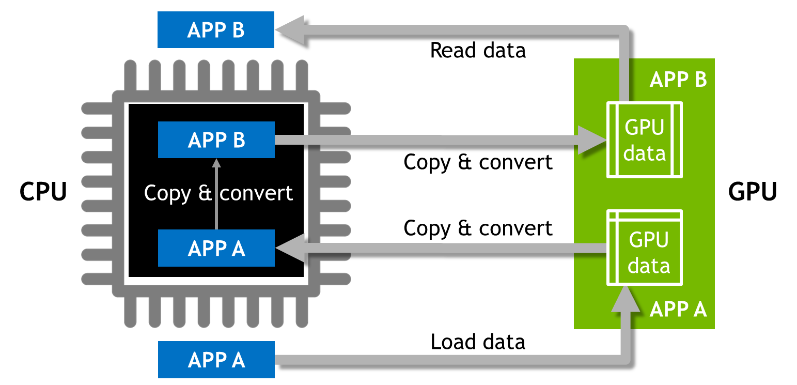
Traditional Model
Too much data movement and too many makeshift data formats require transformation

Slide 27
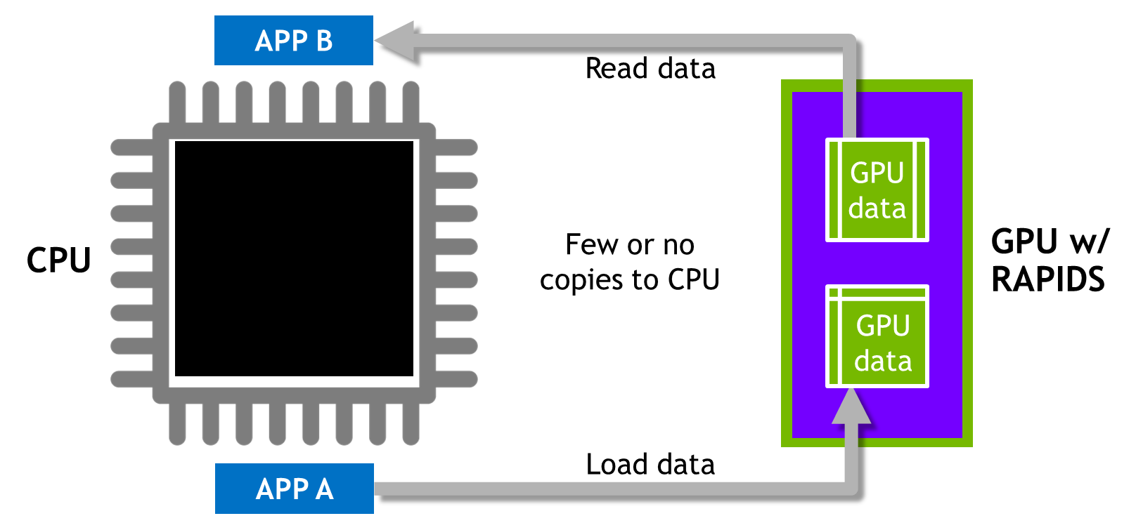
RAPIDS Model
Shared, standard data structures are essential to building an efficient workflow

Slide 28
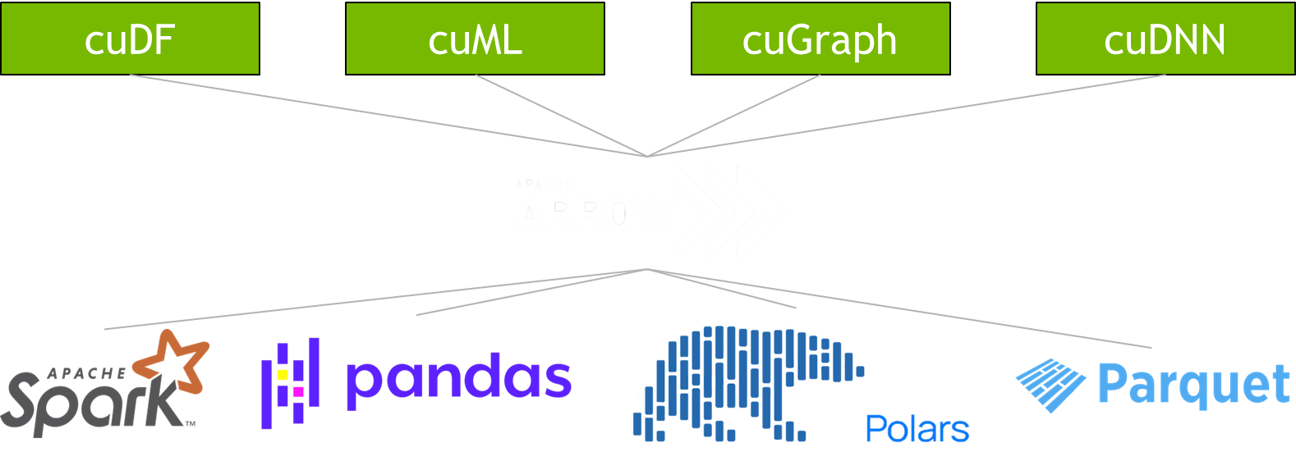

One Format for Interoperability and Efficiency
Standardized, language-agnostic in-memory columnar format for structured data

Slide 29
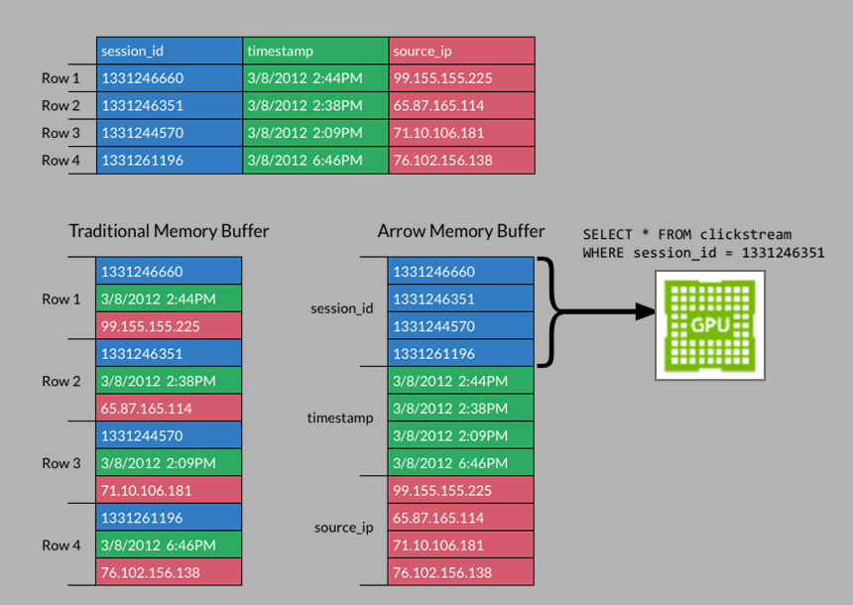
Apache Arrow
Open-source, cross-language development platform for in-memory data processing and analytics
Standardized In-Memory Columnar Format
Data is stored column-by-column instead of row-by-row
Enables efficient compression by grouping similar data types together
Common data representation that can be shared across different systems and programming languages without copying or transforming
Eliminates the need for serialization and deserialization between systems or processes
Direct access to data in memory allows for zero-copy reads, reducing memory requirements
Columnar format enables vectorized processes using SIMD (single instruction, multiple data) operations
Integrates well with columnar file formats such as Parquet, allowing for efficient reading of data from disk
Supports Complex Data Types
Columnar layout leverages GPU strengths

Slide 30
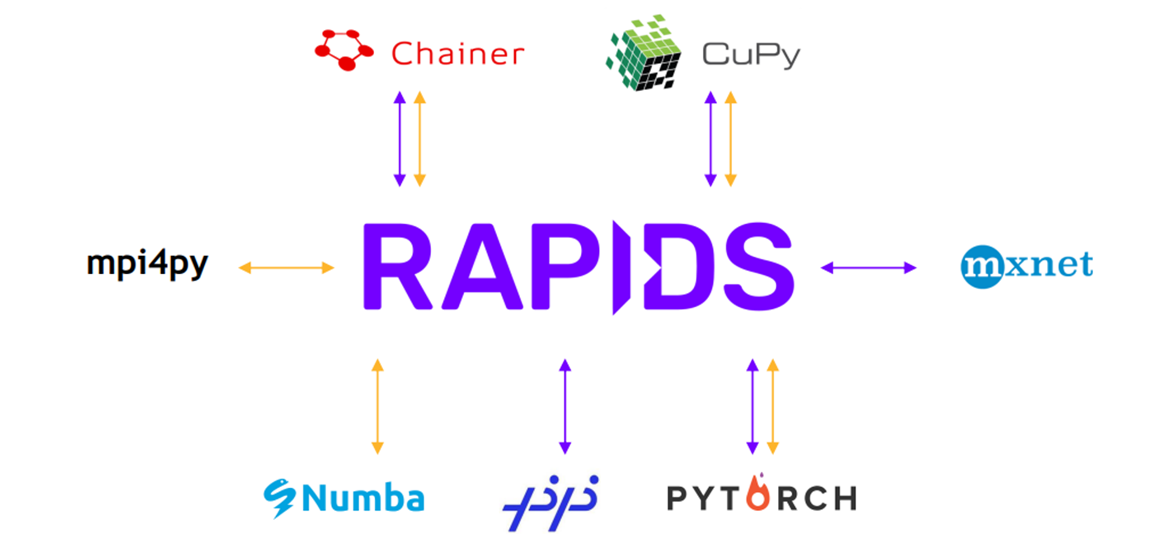
Interoperability with CuPy
Interoperability of the GPU PyData Ecosystem
Using DLPack and __cuda_array_interface__ – the CUDA array interface is a standard format that describes a GPU array to allow sharing GPU arrays between different libraries without needing to copy or convert data

Slide 31
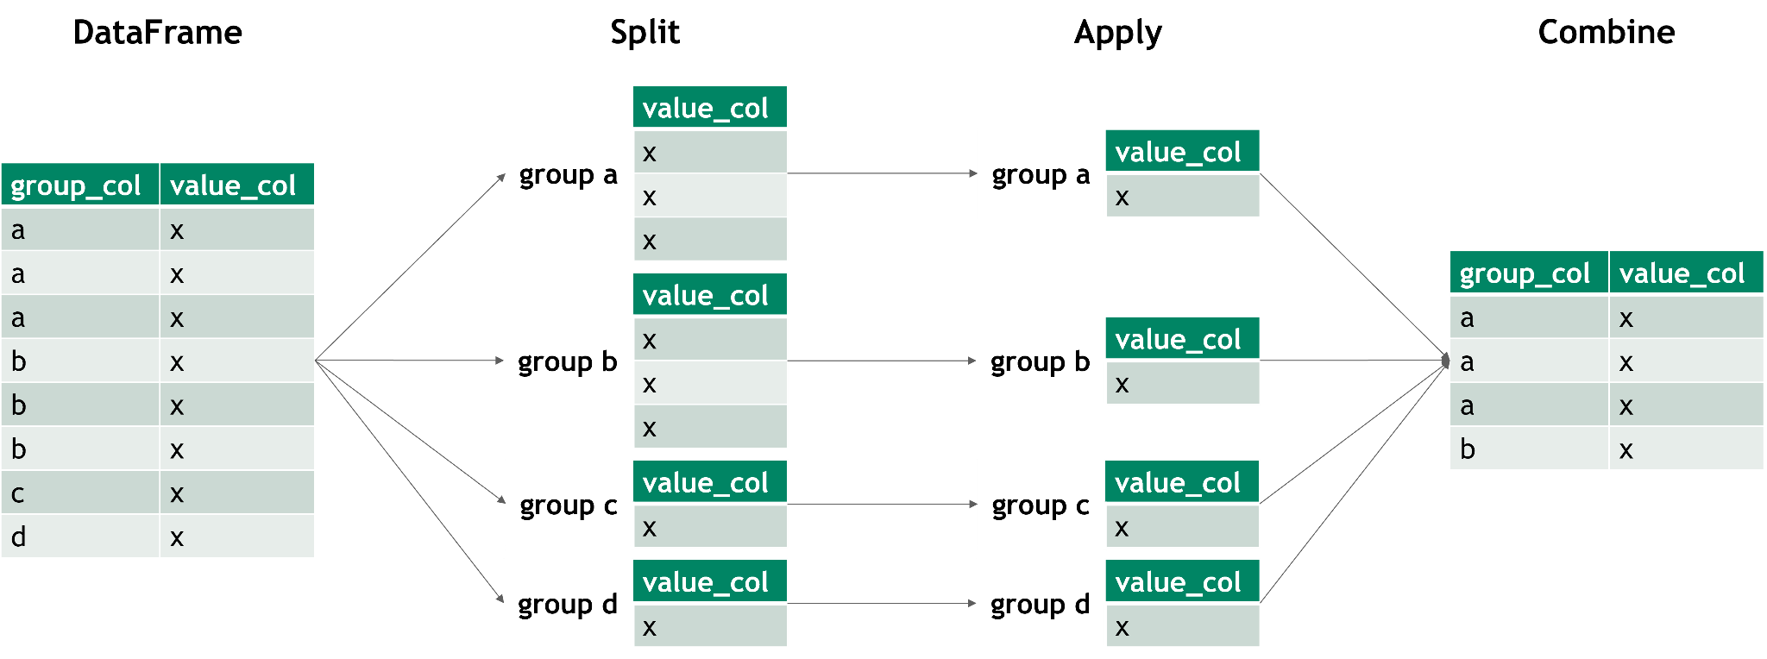
Groupby
Split-apply-combine
Groupby allows you to separate data into groups and apply aggregation function. This helps in summarizing large datasets and extracting meaningful insights.
DataFrameGroupBy
computations / descriptive stats
.agg/aggregate - compute a summary statistic (or statistics) for each group
.transform - perform some group-specific computations and return a like-indexed object
.apply - apply function group-wise and combine the results together

Slide 32
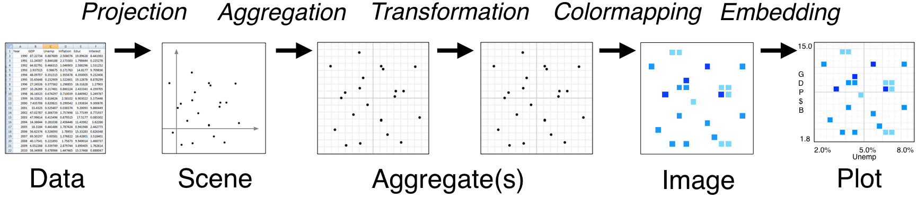
Interactive Visualization
Disruption due to slow processing speed creates friction in the analysis process
While data visuals are an effective tool for explaining data insights at the end of a project, they should ideally be used throughout the data exploration and enriching process. Visualization excels at enhancing data understanding by finding outliers, anomalies, and patterns not easily surfaced by purely analytical methods.
Interactions such as filtering, selecting, or re-rendering points that are slower than 7-10 seconds result in a disruption of a user’s short-term memory and train of thought. This disruption creates friction in the analysis process.
Datashader - a graphics pipeline system for creating meaningful representations of large datasets quickly and flexibly
Work by rasterizing or aggregating large datasets into regular grids that can be viewed as images.

Slide 33
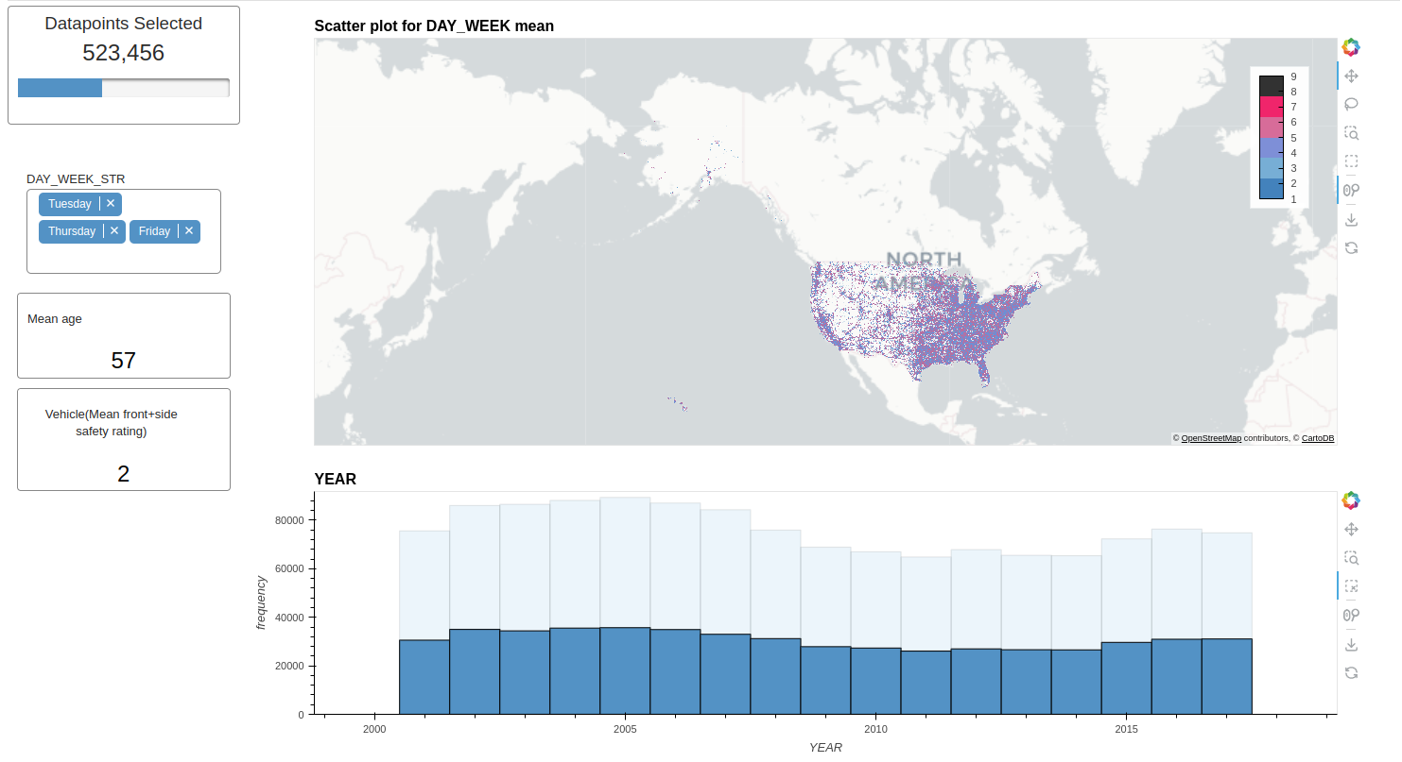
cuxfilter (cu-x-filter)
Cross-filtering apply interactions from one chart as filters to other charts in the dashboard
Efficient GPU-backed in-browser visualization engine
Built on a host of pyViz ecosystem tools
Bokeh and Datashader charts
Interact with multiple charts with cross-filtering widgets

Slide 34
Polars
High Performance DataFrame Library written in Rust.
Gaining rapid adoption in data science community as a Pandas alternative.
Key Differences from existing libraries:
Significantly faster performance, especially for large datasets
Leverages all CPU cores with parallel processing
Build on Apache Arrow columnar memory format
Lazy Execution & Query Optimizer
Streaming API allows data to be processed in batches

Slide 35
Lazy Execution and Query Optimization
Lazy Execution
Polars uses lazy evaluation by default, but has eager execution available
Queries are not executed immediately, but built into an execution plan
Benefits of lazy evaluation:
Allows global query optimization
Minimizes unnecessary computations and memory usage
Enables out-of-core processing for datasets larger than RAM
Query optimizer:
Analyzes full query plan to determine most efficient execution
Applies optimizations like predicate pushdown and projection pushdown
Parallelizes operations across CPU cores automatically

Slide 36
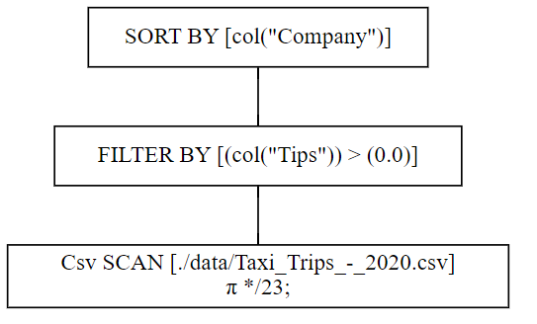
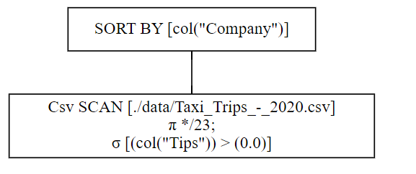
Example of Query Optimization
In this example, Polar’s execution engine decided to filter the column at the same time the csv is being loaded- saving compute power and speeding up runtimes!
Unoptimized Query
Optimized Query

Slide 37
Polars + RAPIDS cuDF
NVIDIA RAPIDS accelerates Polars through a GPU engine built into the lazy API.
The GPU Engine object can be passed to query execution for automatic acceleration (collect() function).
Execution Process
Polars builds and optimizes the query plan
cuDF inspects the plan, replacing supported operations with GPU-accelerated versions
Unsupported operations fallback to CPU execution with minimal overhead.

Slide 38
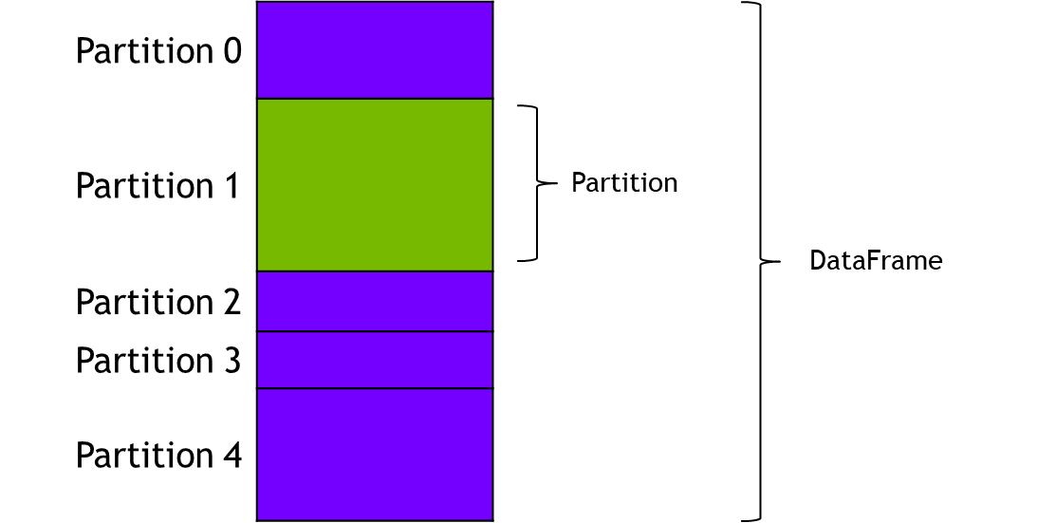
Distributed Computing
Scaling seamlessly
Distributed computing frameworks:
Accelerator for Apache Spark
Distributed computing with Dask
Dask-cuDF
NVTabular (tightly integrated with Dask-cuDF)
How it works:
Data is split into many smaller DataFrames, which we call chunks/partitions
Uses familiar APIs as those found in the PyData ecosystem.
APIs for entire DataFrame object, but methods operate across partitions
Support for multi-GPU, multi-node
Able to handle massive datasets but introduces node-to-node communication
Important to rebalance data across workers when necessary

Slide 39
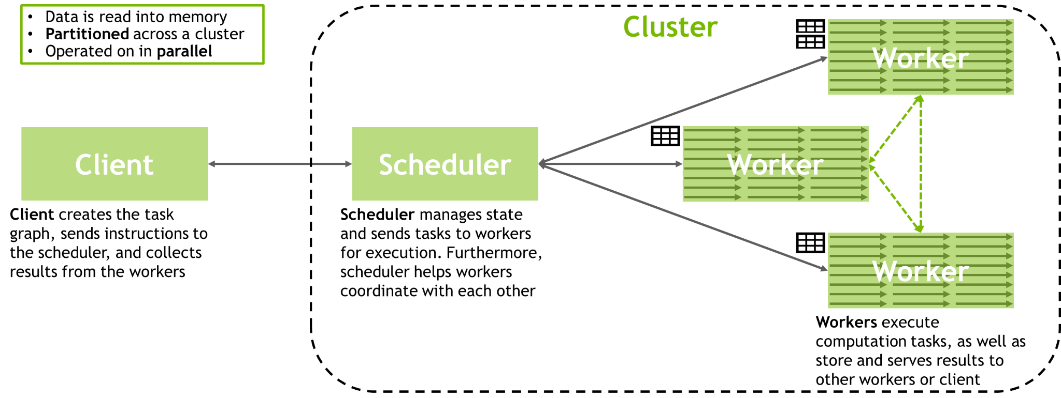
RAPIDS + Dask
Distributed parallel computing on multi-GPU
Dask is a parallel computing library built to scale Python workloads from single machines to supercomputer clusters
Executes operations on chunks of data and aggregates results, thus enabling working with datasets that are larger than memory
scheduler coordinates the actions of several dask-worker processes spread across multiple machines
Operations on Dask DataFrame build task graphs, which are optimized prior to execution

Slide 40
Accelerating Data Processing
Choosing tools based on use case, data size, performance requirements, and existing infrastructure
pandas
User Friendliness
Polars
Spark | Dask
Performance
operates in-memory
eager execution
suited for smaller datasets (up to 1GB)
handles larger-than-memory data
lazy execution
suited for medium to large datasets (1GB - low hundreds GB)
distributed computing
lazy execution
suited for massive datasets across cluster of machines
requires more setup, overhead, and resources

Slide 41
Accelerating Data Processing
Choosing tools based on use case, data size, performance requirements, and existing infrastructure
pandas
User Friendliness
ACCELERATED BY RAPIDS cuDF
Polars
Spark | Dask
Performance
operates in-memory
eager execution
suited for smaller datasets (up to 1GB)
handles larger-than-memory data
lazy execution
suited for medium to large datasets (1GB - low hundreds GB)
distributed computing
lazy execution
suited for massive datasets across cluster of machines
requires more setup, overhead, and resources

